Slide 1
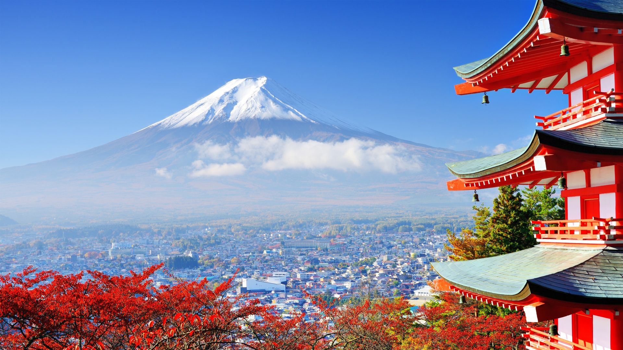
Japan 2023 Trip

Slide 2
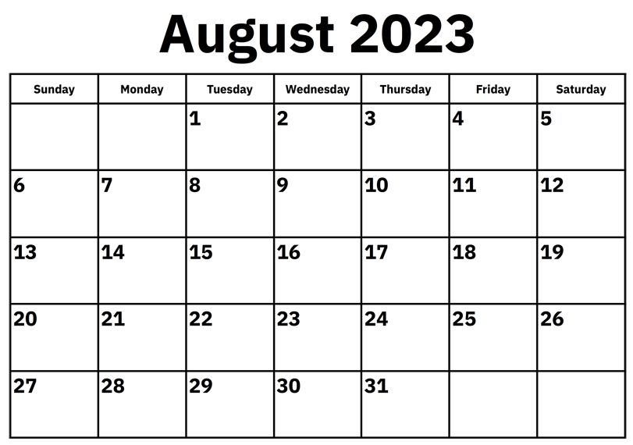
Trip Calendar
Fly In
Tokyo
Tokyo
Kyoto
Osaka
Fly out

Slide 3
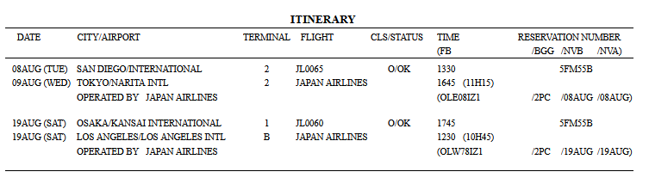
Flight Information – Group 1

Slide 4
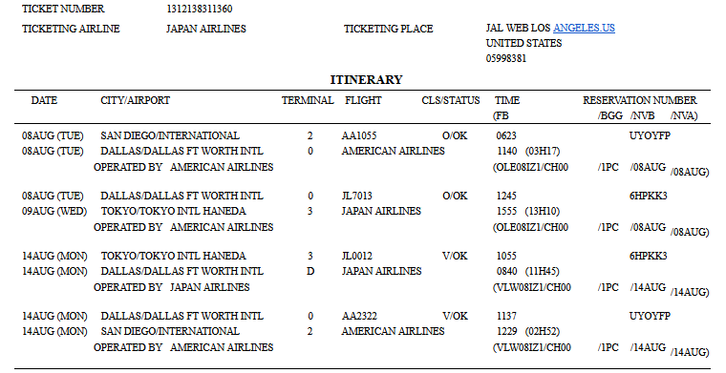
Flight Information – Group 2

Slide 5
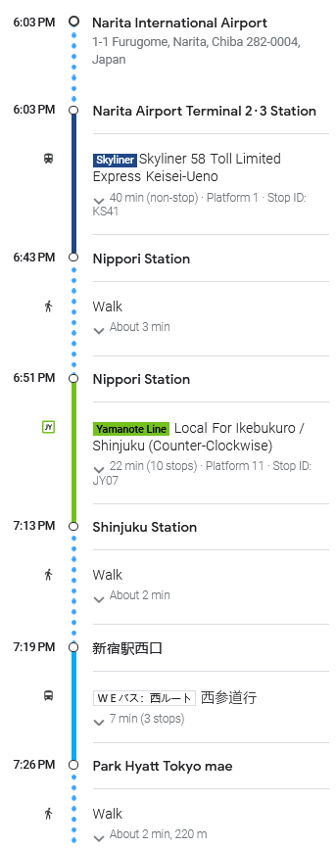
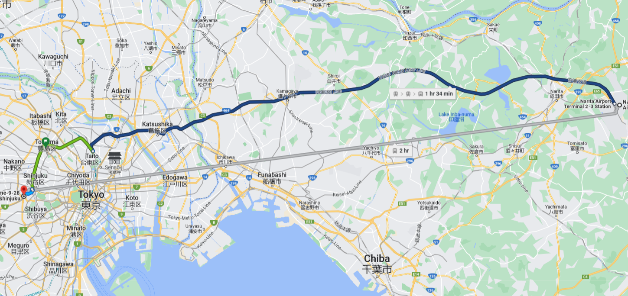
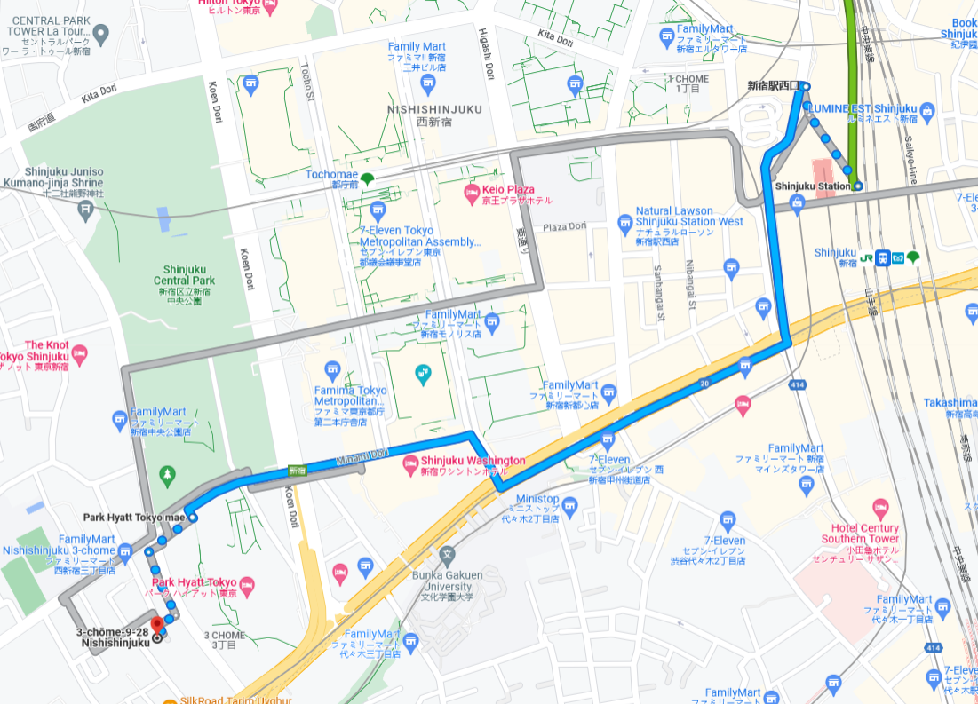
Narita to AirBnB Stay
3-chōme-9-28 Nishishinjuku, Shinjuku City, Tokyo 160-0023, Japan
Tell Taxi driver that you’re near Park Hyatt Tokyo
パークハイアット東京の近くに宿泊
Pākuhaiatto Tōkyō no chikaku ni shukuhaku

Slide 6
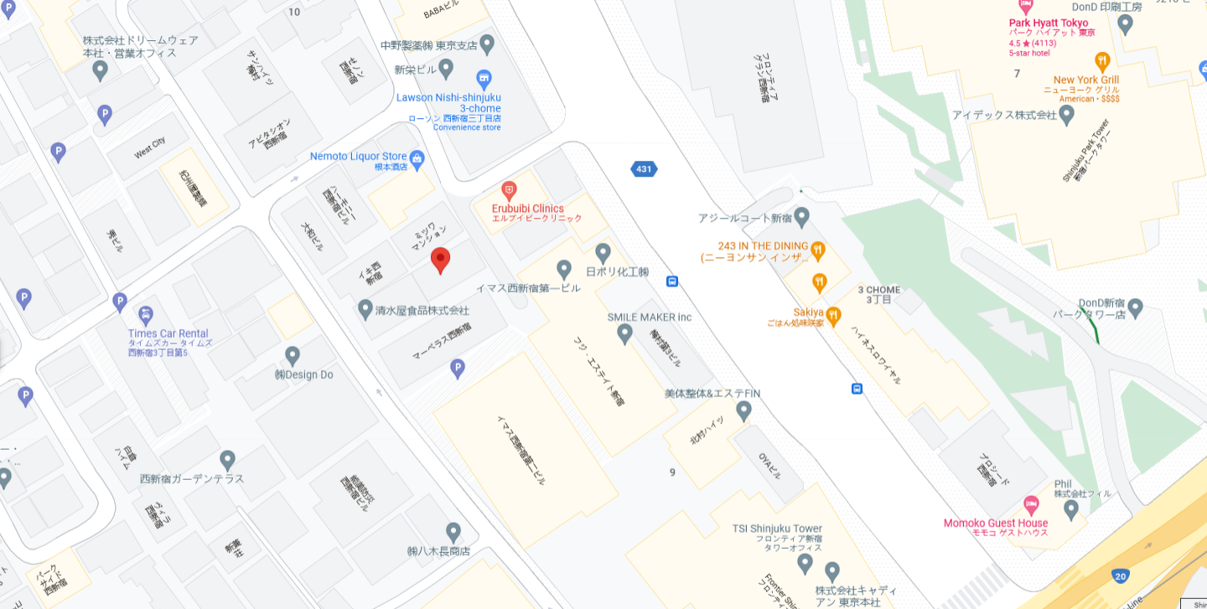
AirBnB Stay
3-chōme-9-28 Nishishinjuku, Shinjuku City, Tokyo 160-0023, Japan

Slide 7
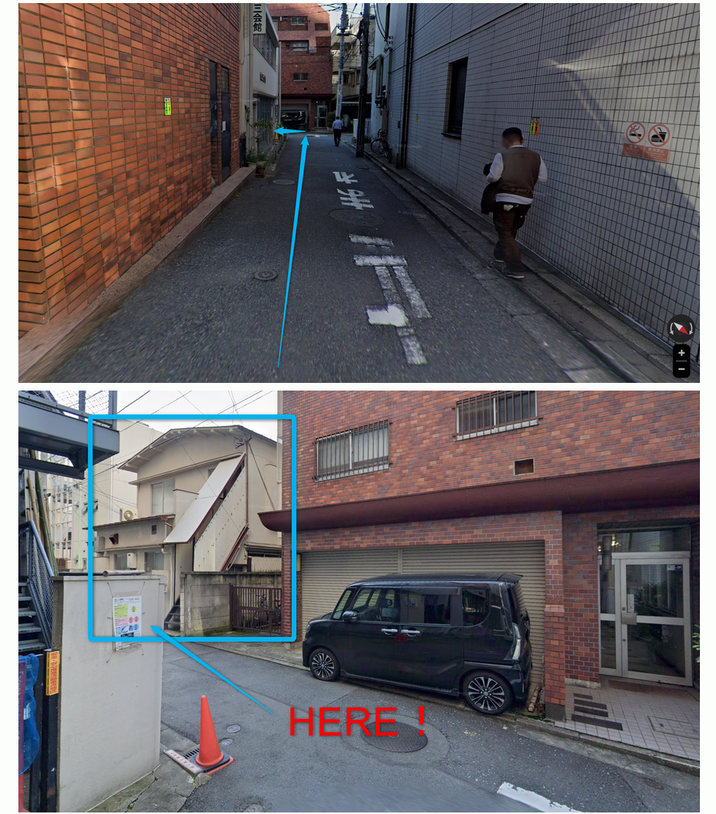
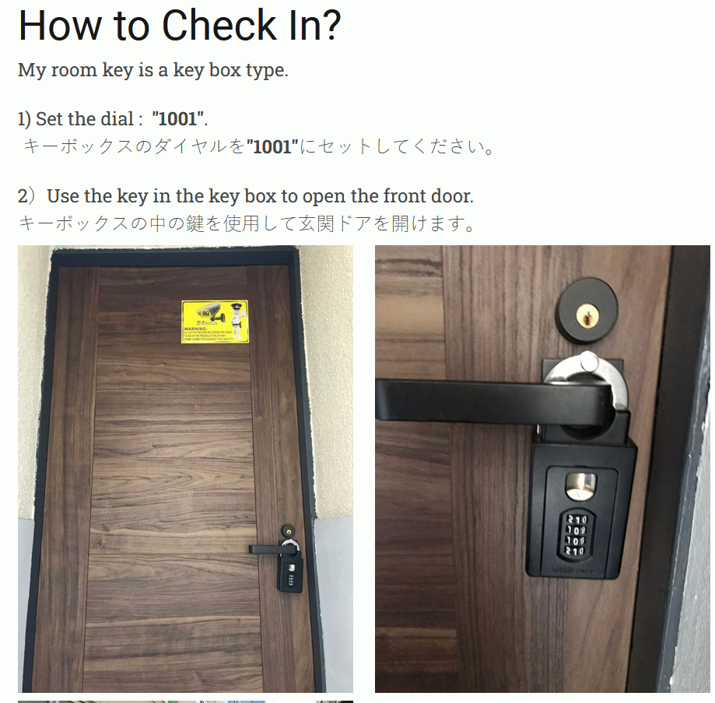
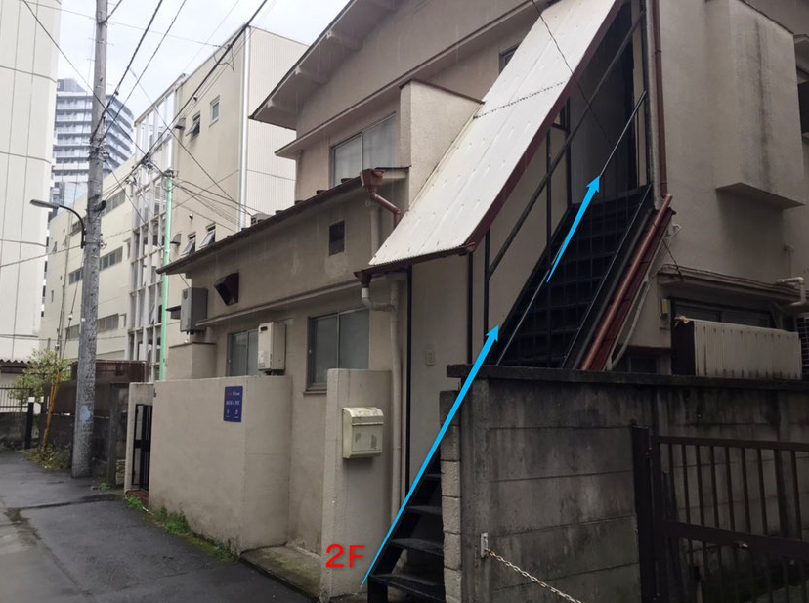
Access AirBnB
https://host-plus.jimdo.com/hf2/
3-chōme-9-28 Nishishinjuku, Shinjuku City, Tokyo 160-0023, Japan

Slide 8
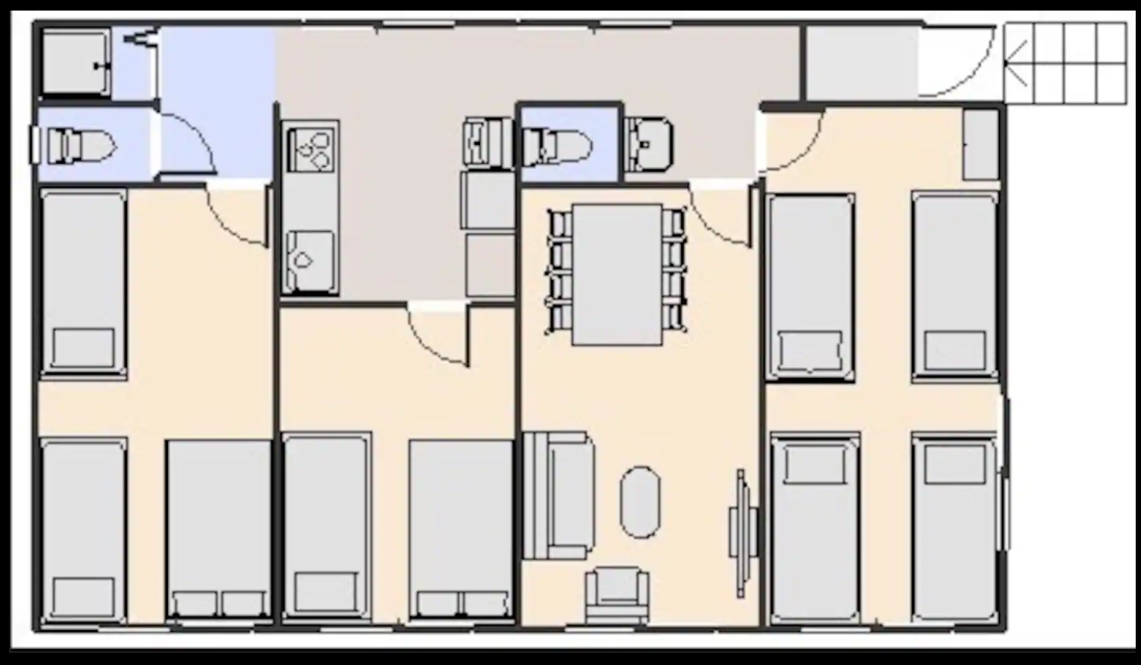
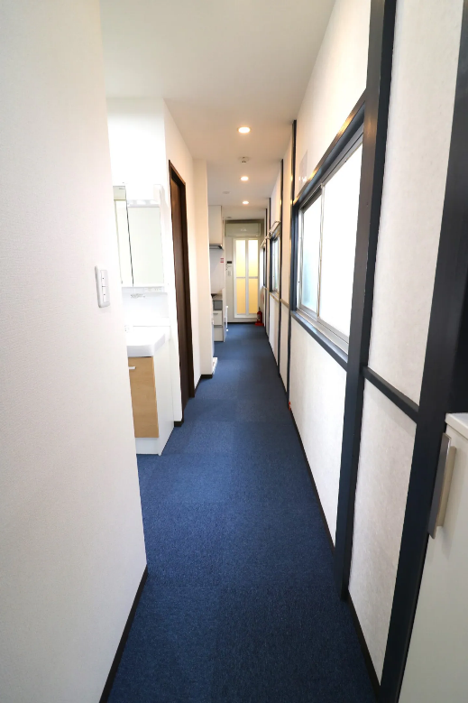
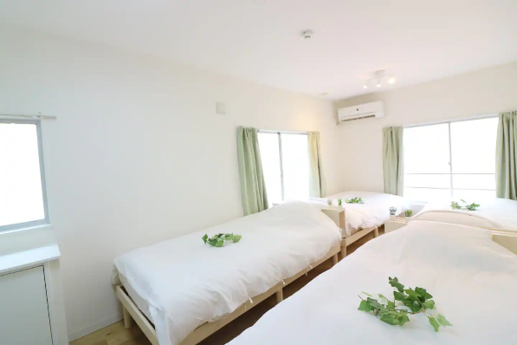
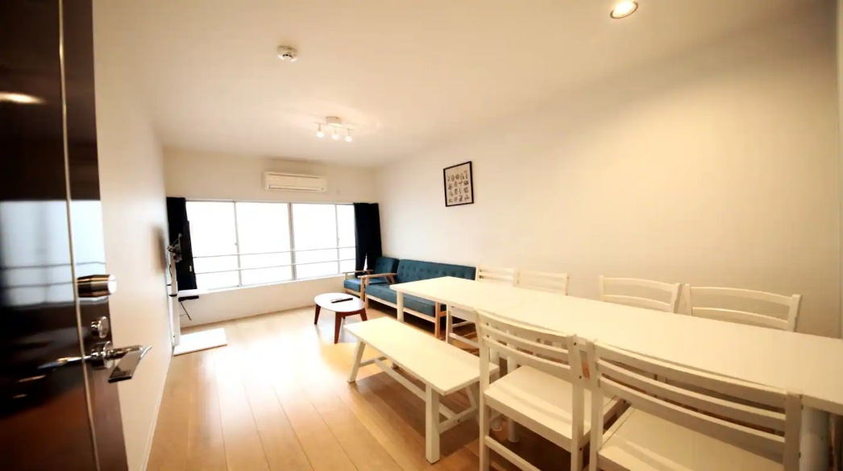
AirBnB Stay
https://www.airbnb.com/trips/v1/830380dd-ae1f-4256-9c93-45099360be62/ro/RESERVATION2_CHECKIN/HME2J32994
Adults
Chris &
Joni?
Otto?
Hetal?

Slide 9
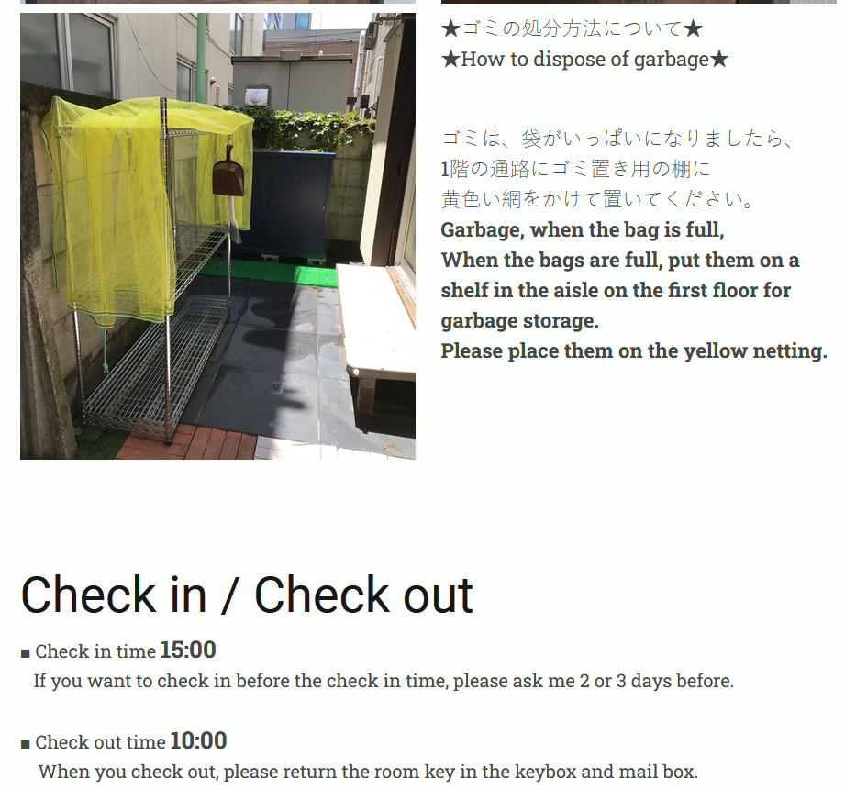
AirBnB - Information

Slide 10
Tokyo Events
August 10 – Thursday
Morning: Meiji Shrine (10:00 to 16:00) – 1000 yen ($7 USD)
Afternoon: Shibuya Crossing / Shibuya Tower View
  Anime Museum https://tokyoanimecenter.jp/en/information/20230714-1/
  Nintendo Store
Adult Evening: https://www.cntraveler.com/bars/tokyo/golden-gai
Adult Evening: New York Bar - Shinjiku
August 11 – Friday
Afternoon: Edo Castle (9:00 a.m. - 5:30 PM) – Try between 2:00-3:30 PM (1 ½ hours hanging out)
Evening: Baseball Game: Giants vs TBD – Before 6:00 PM
August 12 – Saturday
Day: Odaiba Mall (2-3 hours hanging out) – Noon to 2-3 PM
Evening: Sensoji Temple (1 hour hanging out) – 4-5 PM
Evening: Akiabara (2-3 hours easy) – 5:15 PM+
August 13 – Sunday
Odds & Ends
  Chureito Pagoda Mt Fuji View ($40 train round trip per person) (5 hours round trip)
  Noodle Museum
  Robot Restaurant

Slide 11
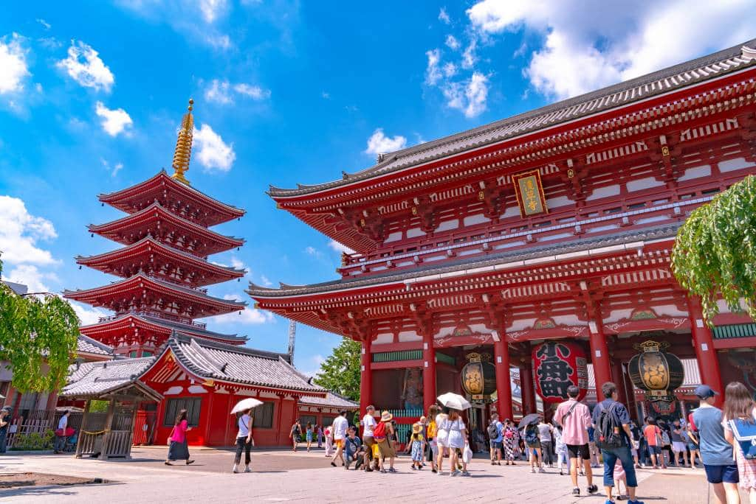

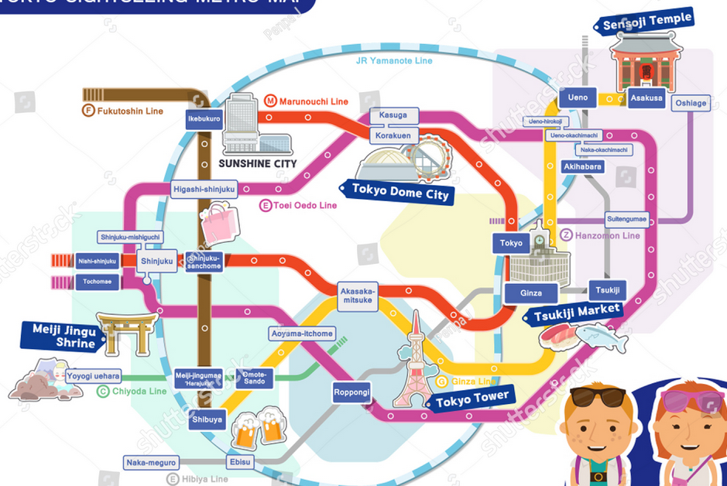
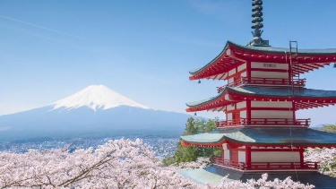
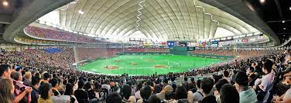
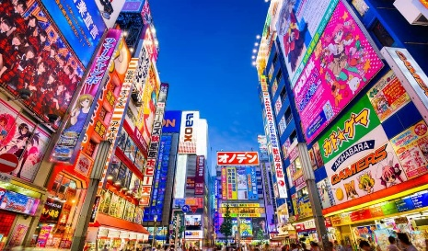
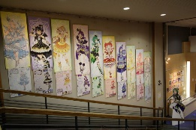
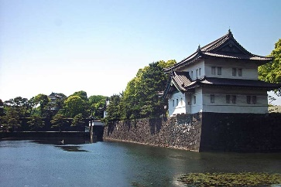
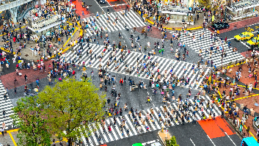
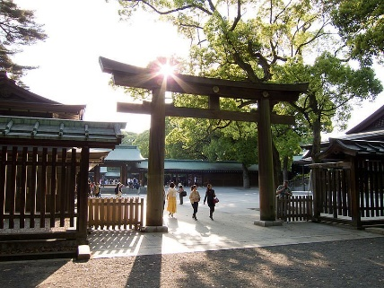
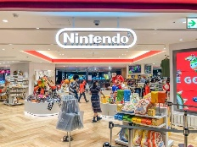
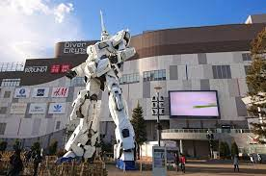
Tokyo Map
Narita Airport
Mount Fuji View
Baseball Game
Edo Castle
Haneda Airport
Odaiba Mall

Slide 12
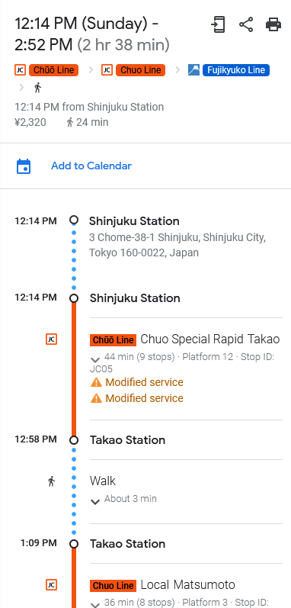
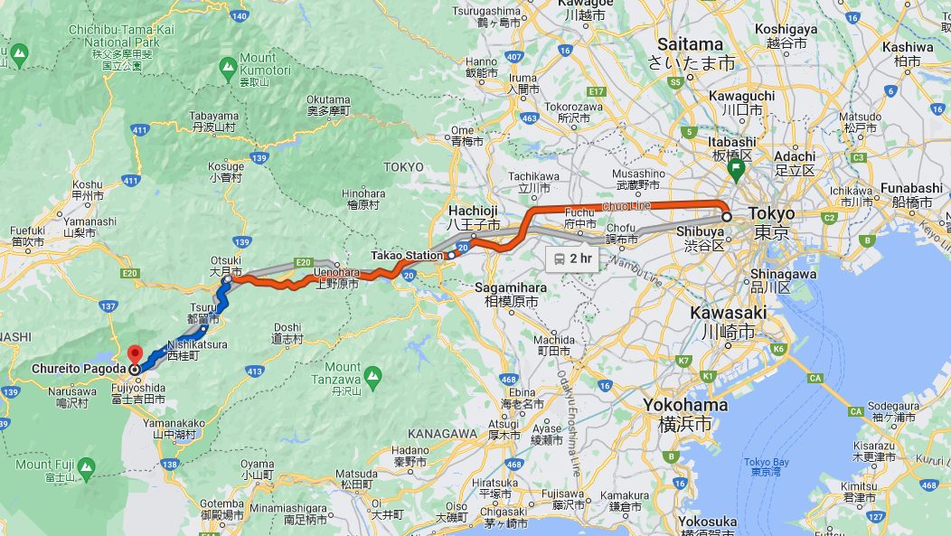
AirBnB Stay to Mt Fuji View
Chureito Pagoda- 2-chome-4-1 Asama, Fujiyoshida, Yamanashi 403-0011, Japan

Slide 13
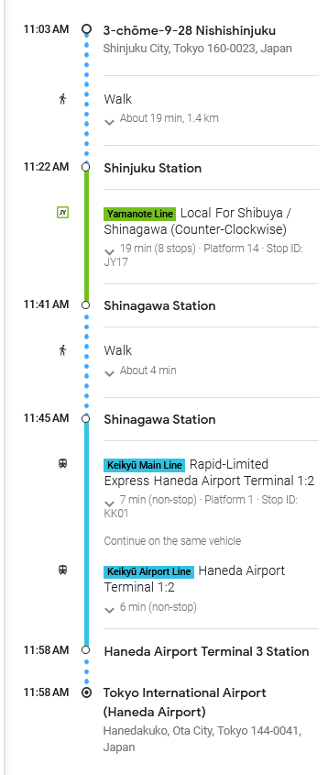
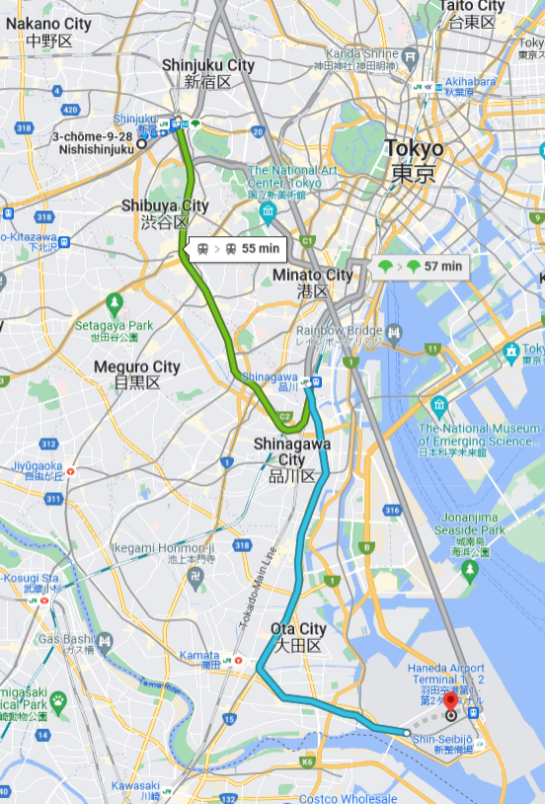
AirBnB Stay to Haneda Airport
3-chōme-9-28 Nishishinjuku, Shinjuku City, Tokyo 160-0023, Japan

Slide 14
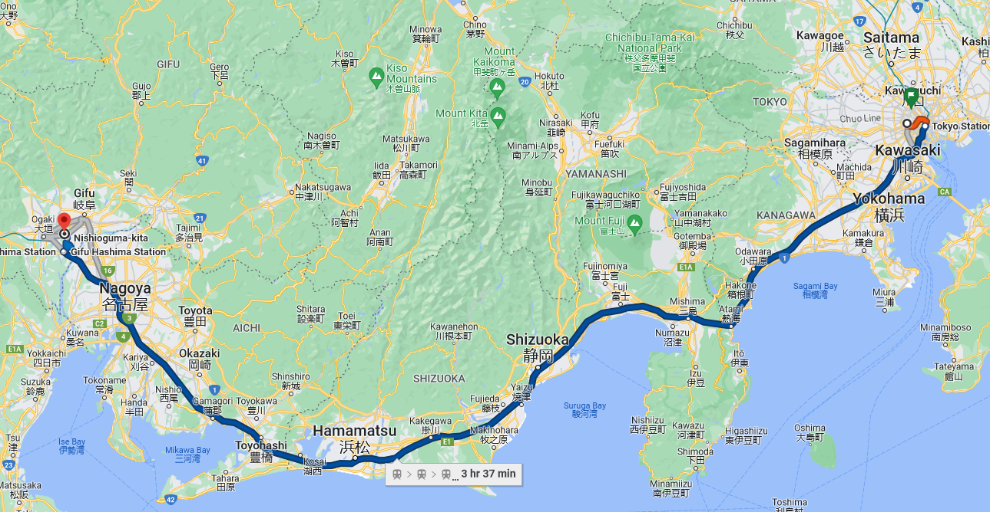
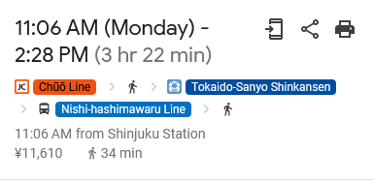
AirBnB Stay to Nagoya

Slide 15
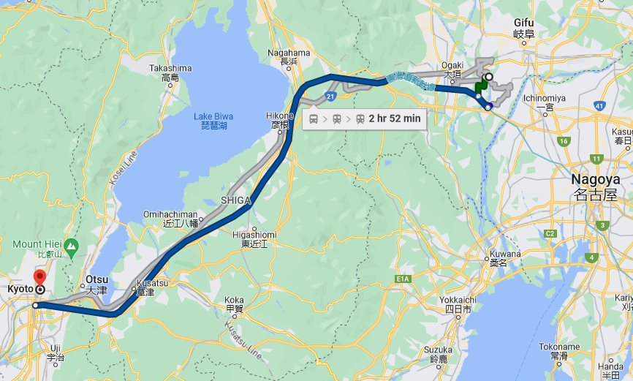
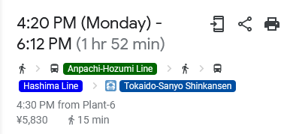
Nagoya to Kyoto

Slide 16
Osaka/Kyoto Events
Kyoto
https://kyotomap360.com/paris-bus-tour-map
Fushimi Inari-taisha Shrine
Kinkakuji Temple
SAMURAI & NINJA MUSEUM with EXPERIENCE
  https://mai-ko.com/tour/samurai-experience-kyoto-samurai-museum-tour-and-armor-trial/
Kyoto Starbucks
Kyoto street walking
Osaka
Universal Studios
Dotombori District
Shinsaibashi-suji Shopping Street
Osaka Castle

Slide 17
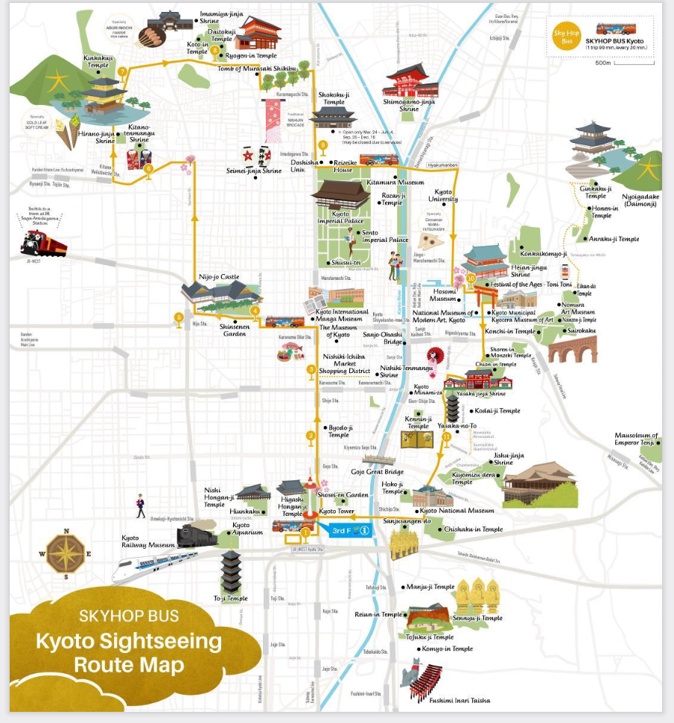
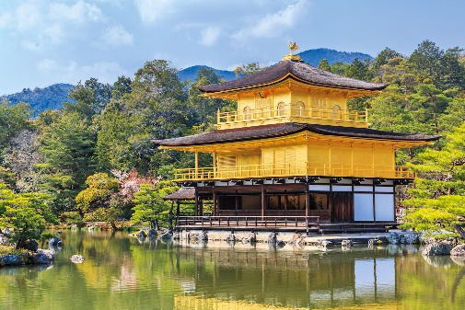
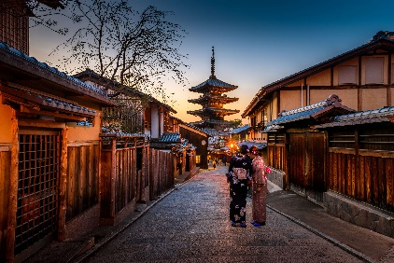
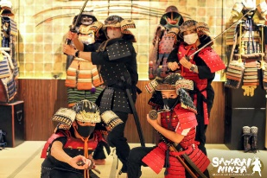
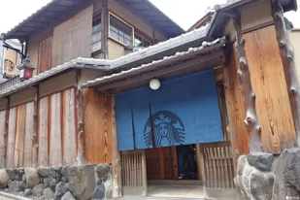
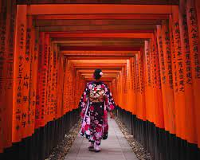
Kyoto Map
Samurai
Musuem
Starbucks

Slide 18
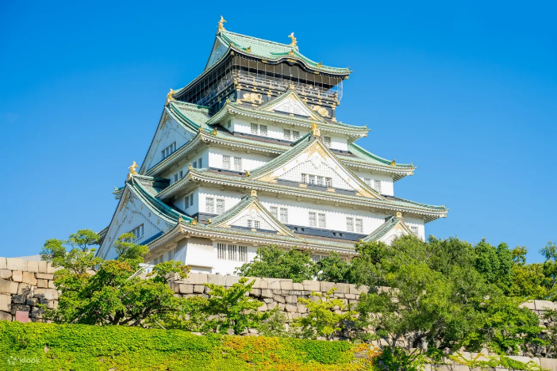
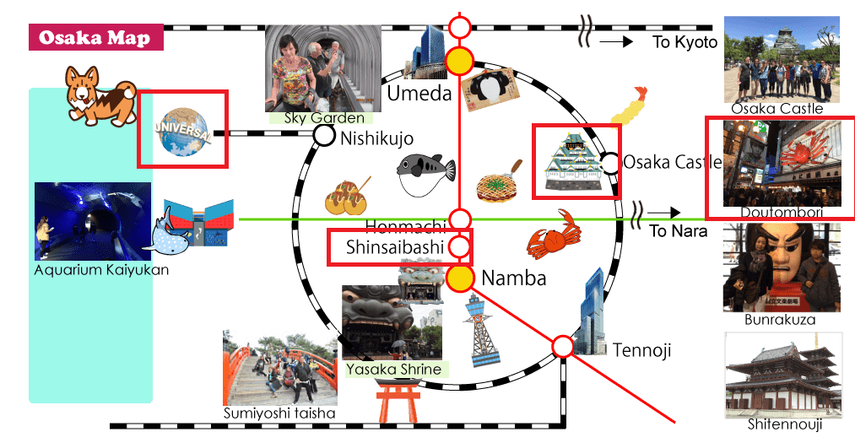
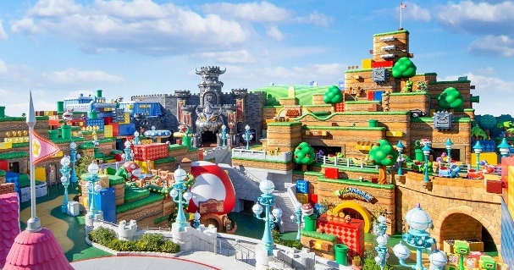
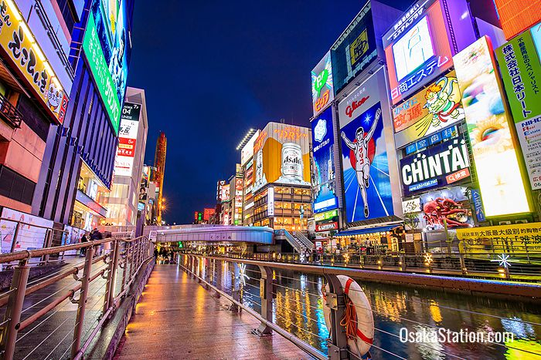
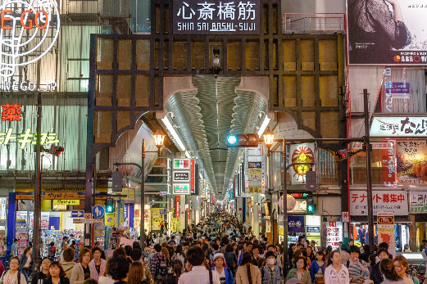
Osaka Map

Slide 19
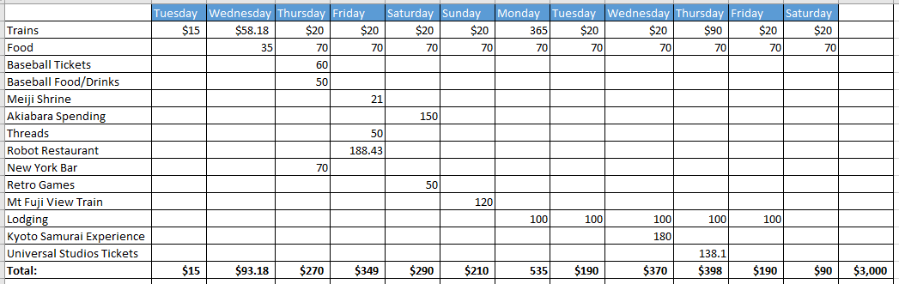
Otto’s Budget

