Slide 1
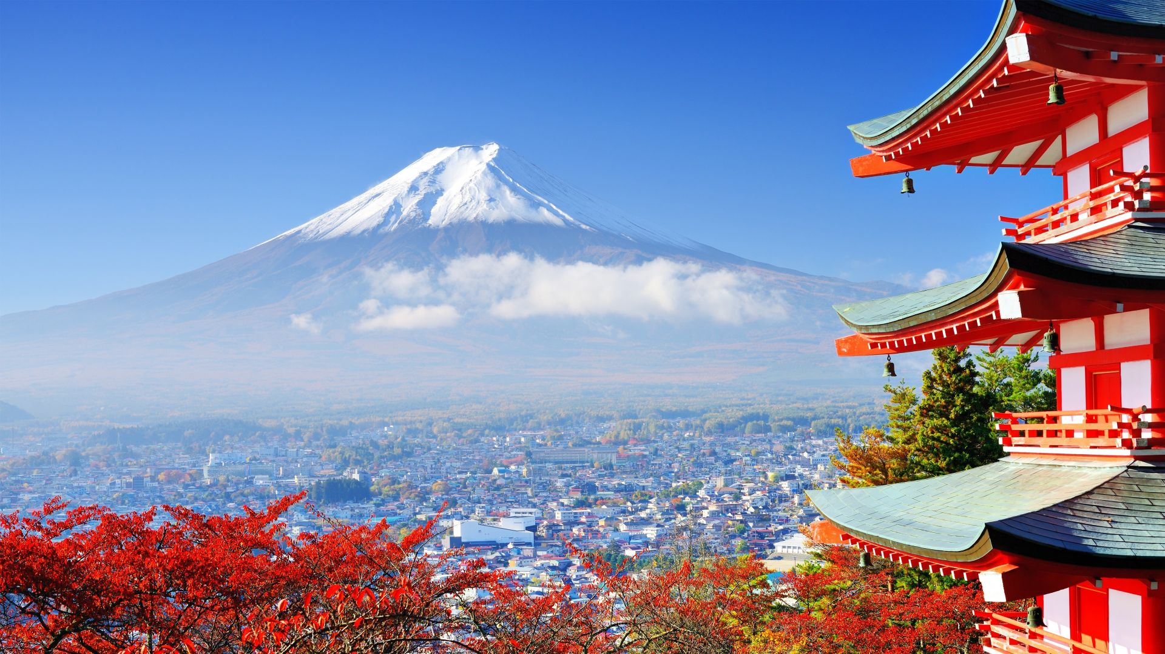
Japan January 2025 Trip

Slide 2
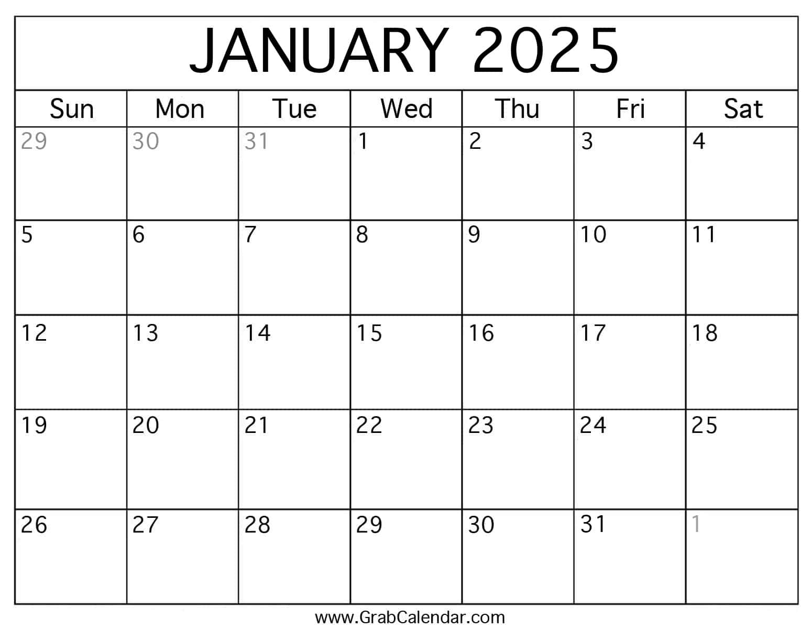
Trip Calendar
LAX
Fly In
Tokyo
Fly Home

Slide 3
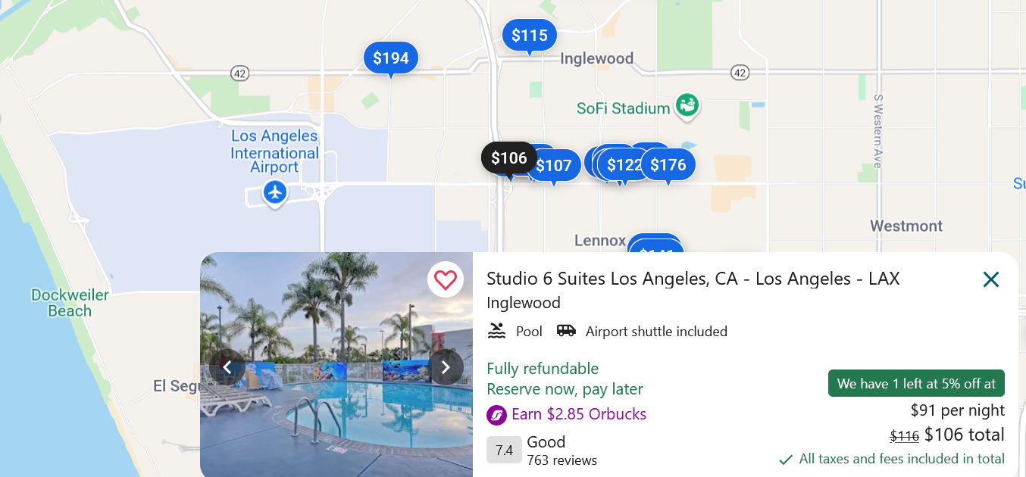
LAX Lodging

Slide 4
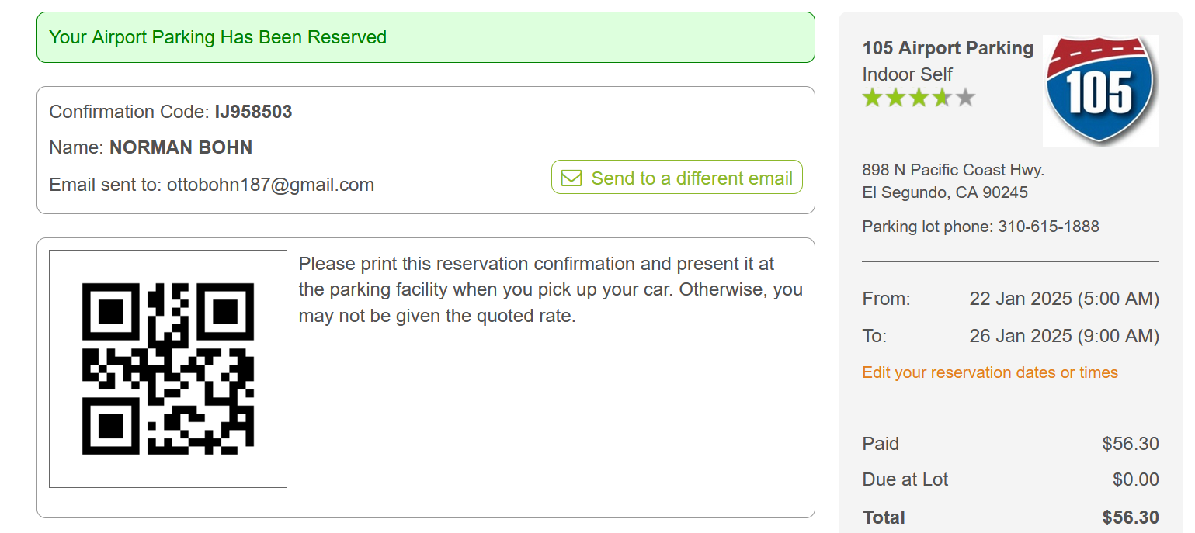
LAX Parking

Slide 5
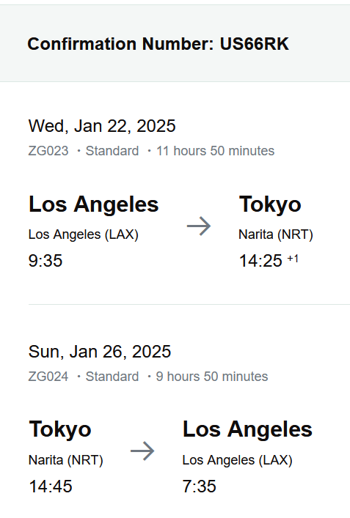
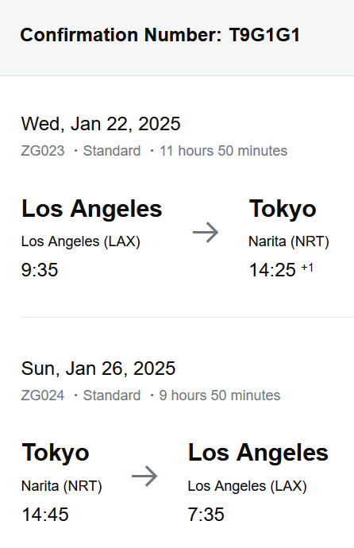
Kipp’s Norman’s

Slide 6
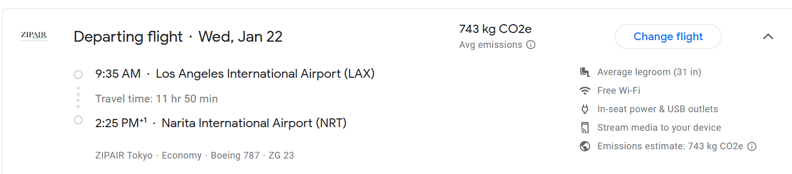
Flight Information – LAX to Tokyo

Slide 7
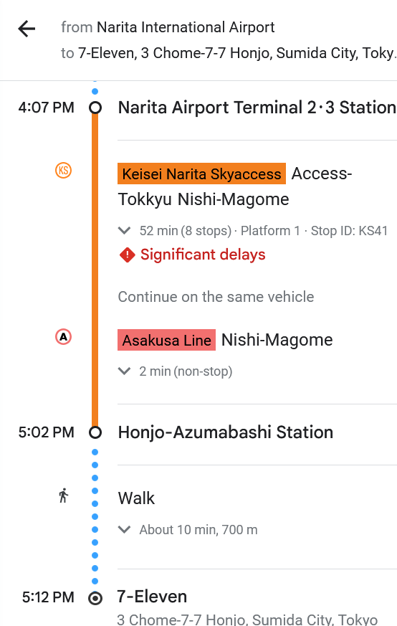
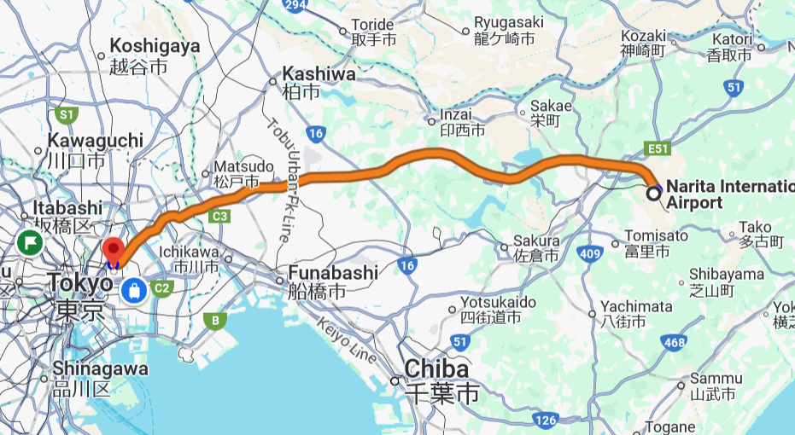
Train – Narita to Lodging

Slide 8
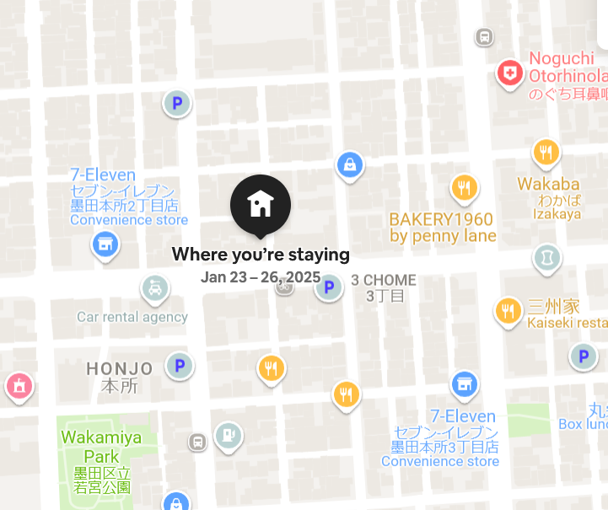
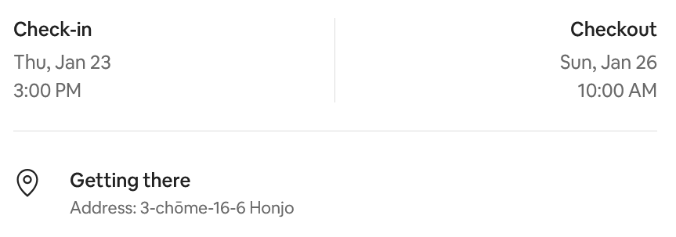
Tokyo Lodging
3-chōme-16-6 Honjo Horizon Bleu ASAKUSA 502号, Sumida City, Tokyo Prefecture 130-0004, Japan

Slide 9
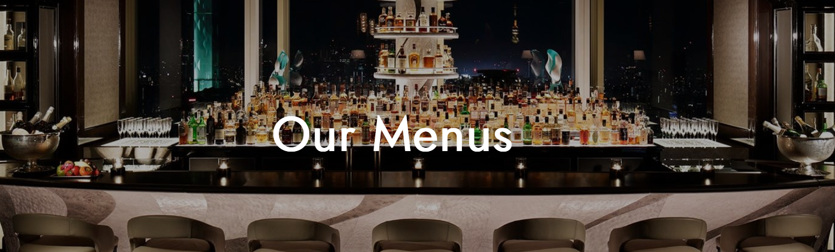
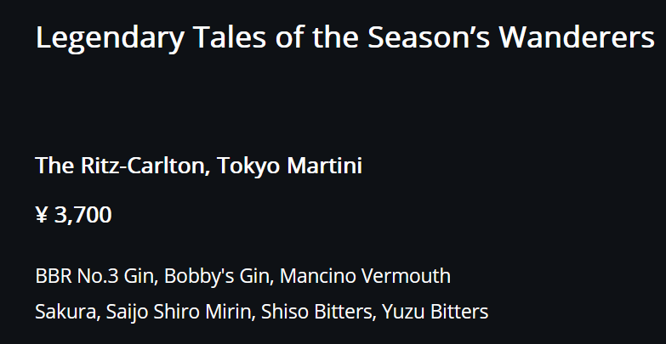
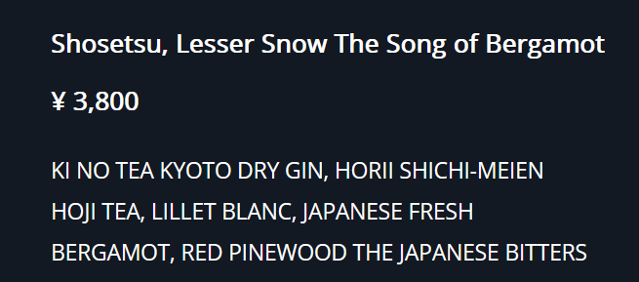
Tokyo Ritz Carlton Bar
https://bar.ritzcarltontokyo.com/en/

Slide 10
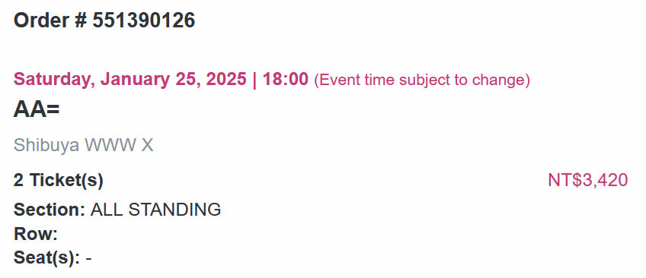
AA= Show

Slide 11
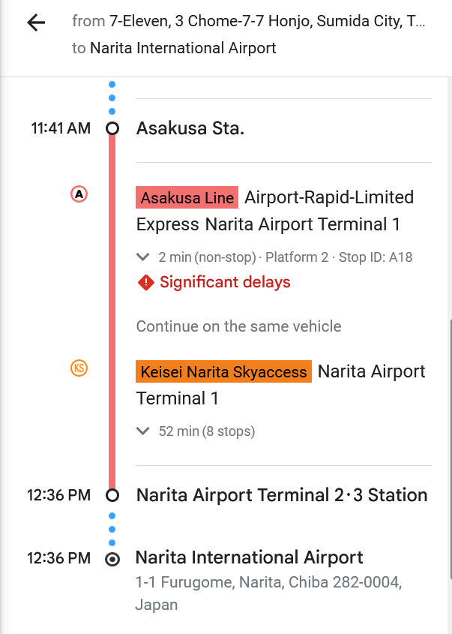
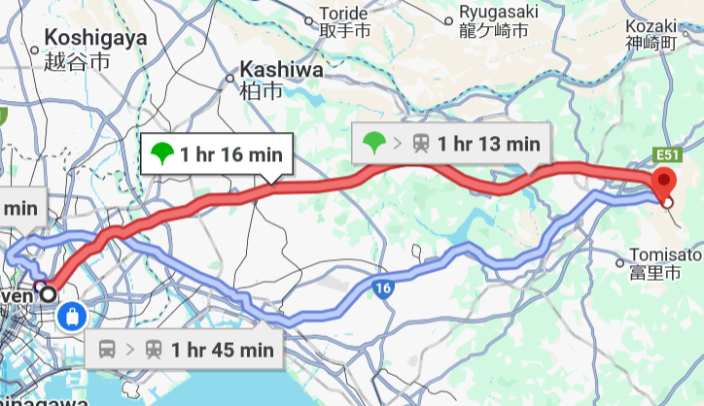
Train – Lodging to Narita

Slide 12
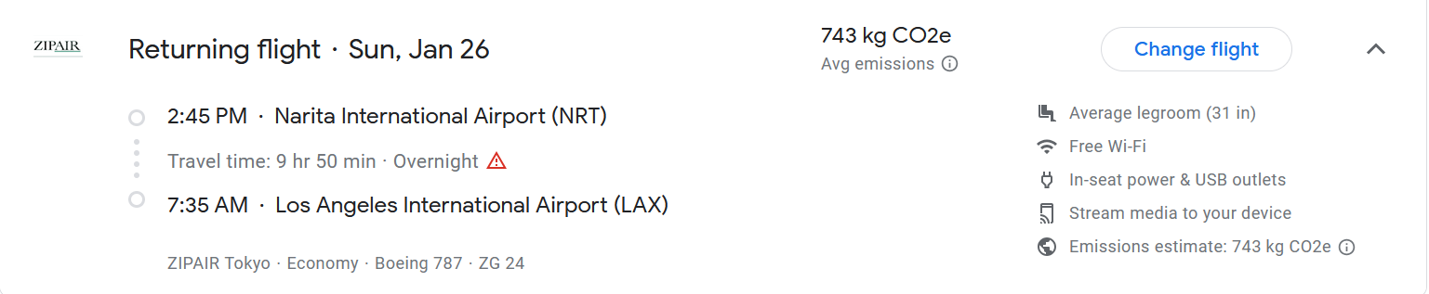
Flight Information – Tokyo to LAX

Slide 13
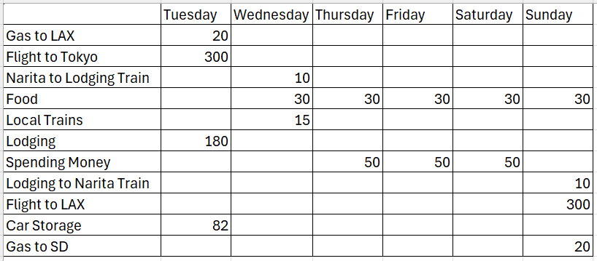
Otto’s Budget

