Slide 1
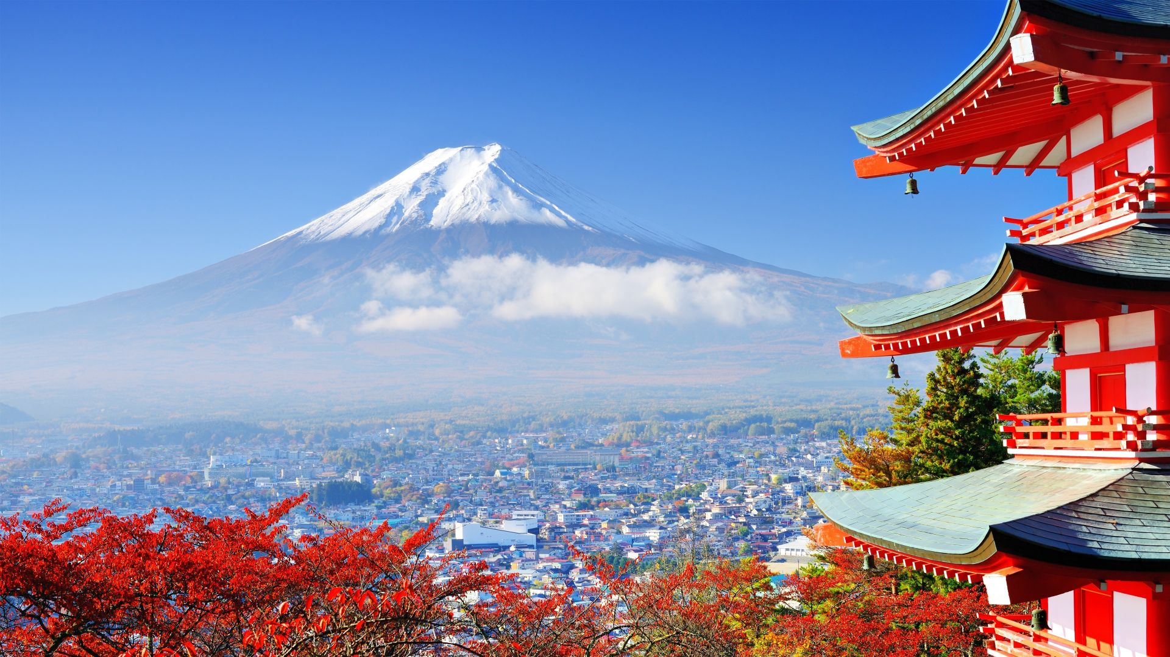
Japan January 2025 Trip

Slide 2
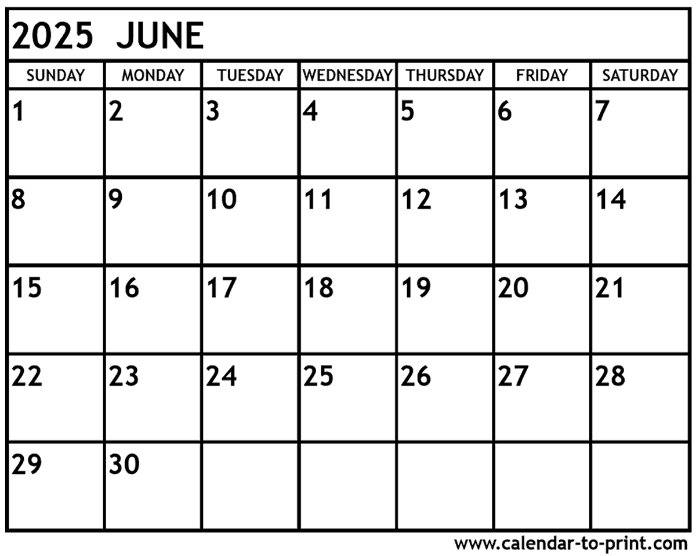
Trip Calendar
Hirajuku / Shinjaku
Hello Kitty
World
Fly In
Fly In
Tokyo
Train
Kyoto
Kyoto Explore
Nara
Osaka Zoo
Chill
Aquarium
Thrifting
Soccer
Kyoto
Osaka
Fly
Okinawa
Chill
Chill
Okinawa
Fly Home

Slide 3
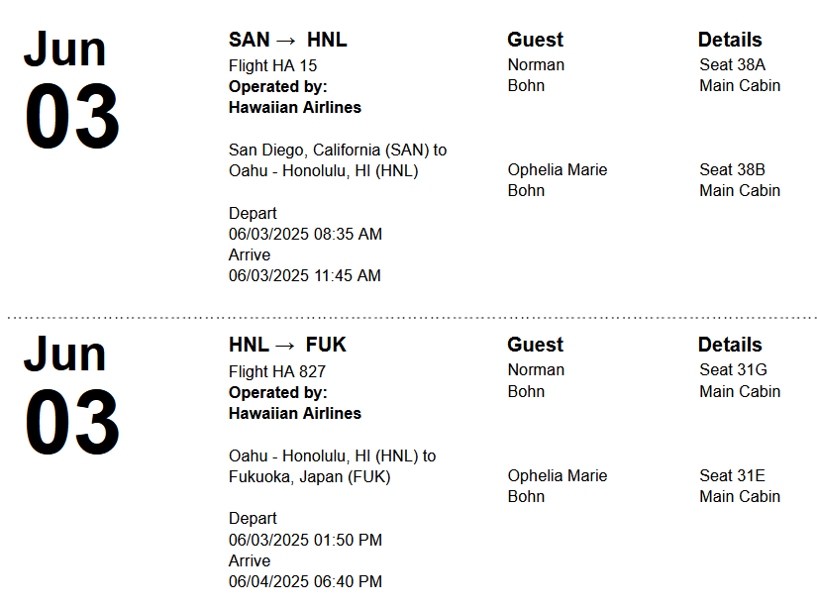
SD to Japan

Slide 4
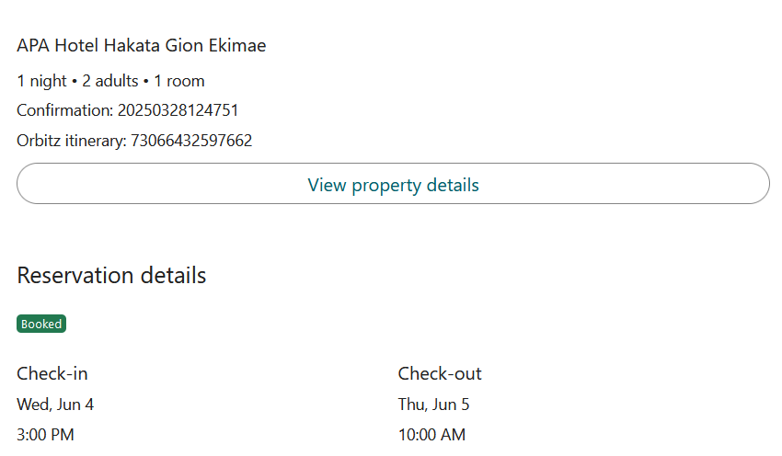
Fukuoka Lodging

Slide 5
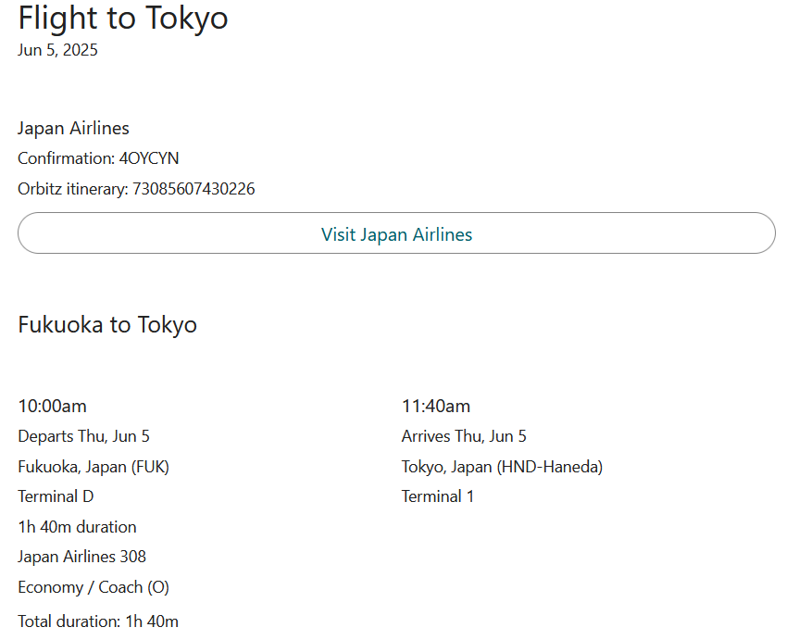
Fukuoka to Tokyo

Slide 6
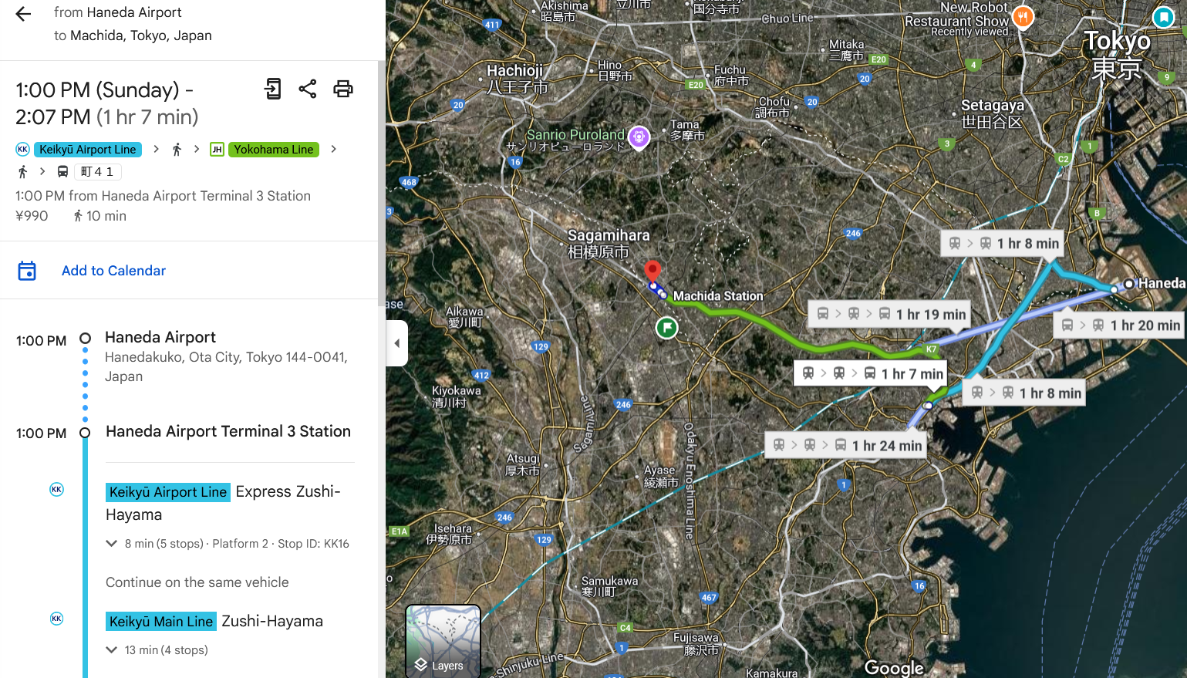
Haneda Airport to Lodging

Slide 7
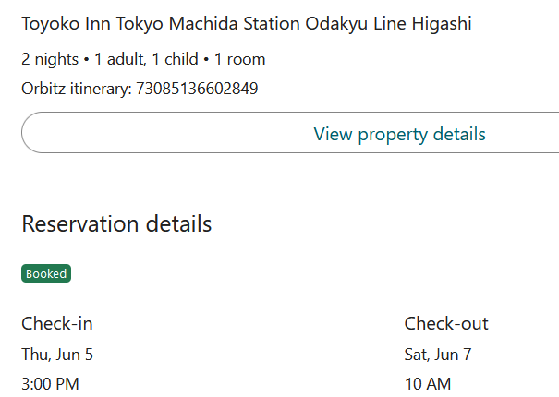
Tokyo Lodging

Slide 8
Tokyo Things to Do
Arrival Day
Shinjuku
Hirajuku
Tokyo Tower?
Full Day
Hello Kitty Land
Machida Thrifts

Slide 9
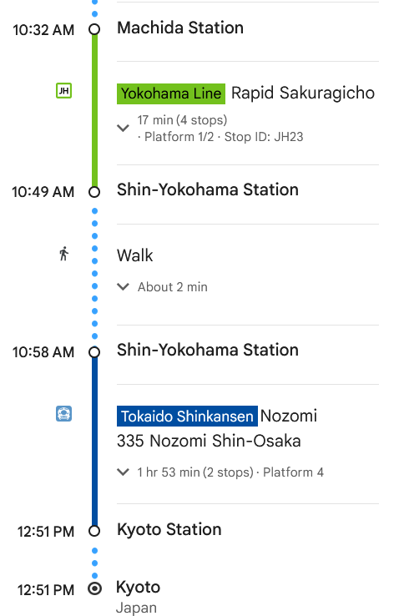
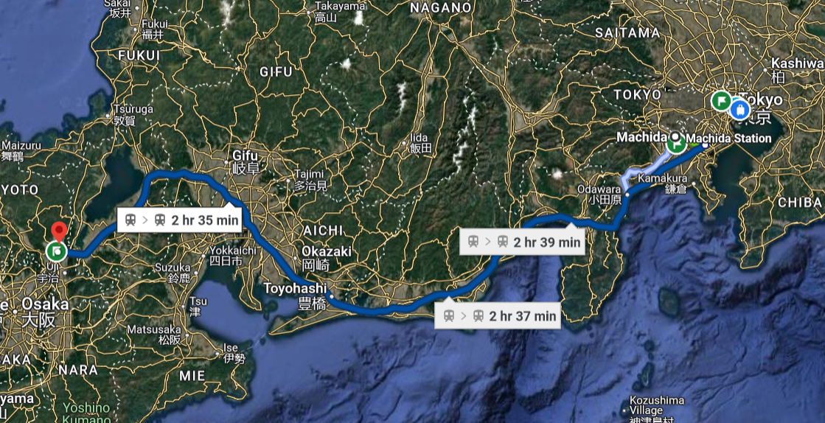
Tokyo to Kyoto Train

Slide 10
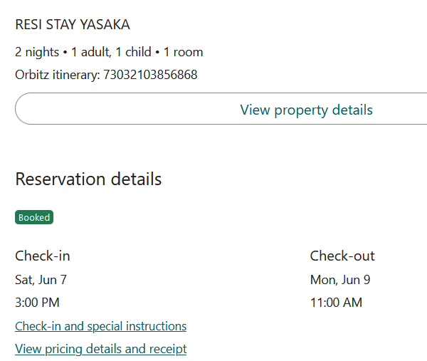
Kyoto Lodging

Slide 11
Kyoto Things to Do
Arrival Day
Starbies
Wander Around Gion and Southern Higashiyama
Fushimi Inari-taisha Shrine:
Full Day
Rent Bikes
Kyoto International Manga Museum?
Wander Around Gion and Southern Higashiyama
Golden Pavilion at Kinkaku-ji Temple
Nintendo Museum?

Slide 12
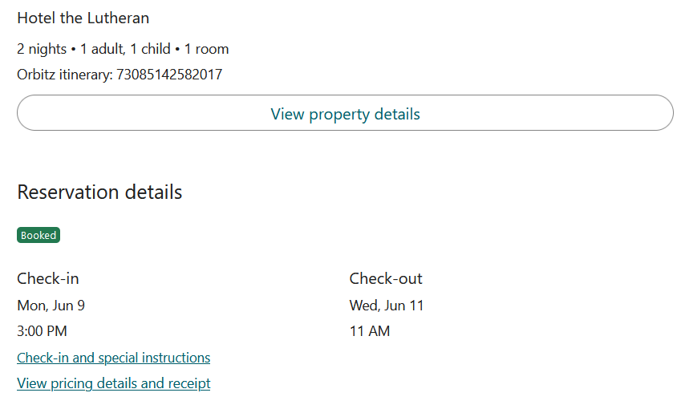
Osaka Lodging

Slide 13
Osaka Things to Do
Arrival Day
Nara Deer
Osaka Castle
Running Man Canal Street
  Starbies
  Strawberry Icecream
Full Day
Osaka Zoo - https://www.tennojizoo.jp/en/
Abeno Harukas Observatory

Slide 14
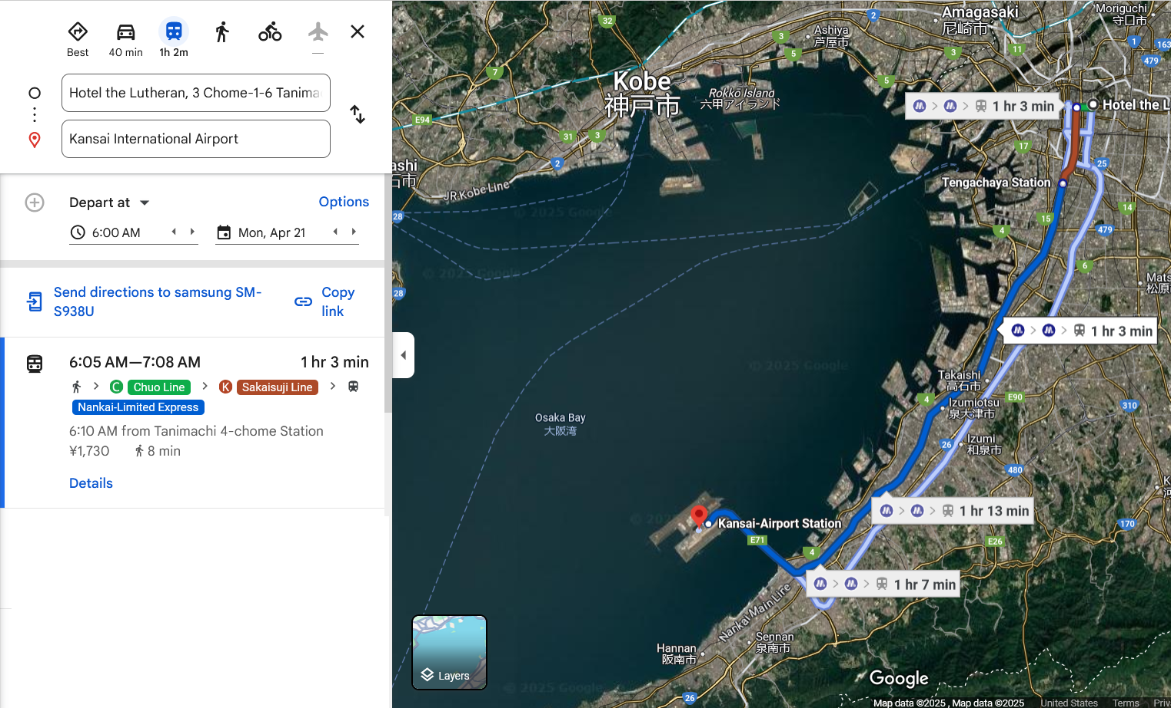
Osaka Lodging to Airport

Slide 15
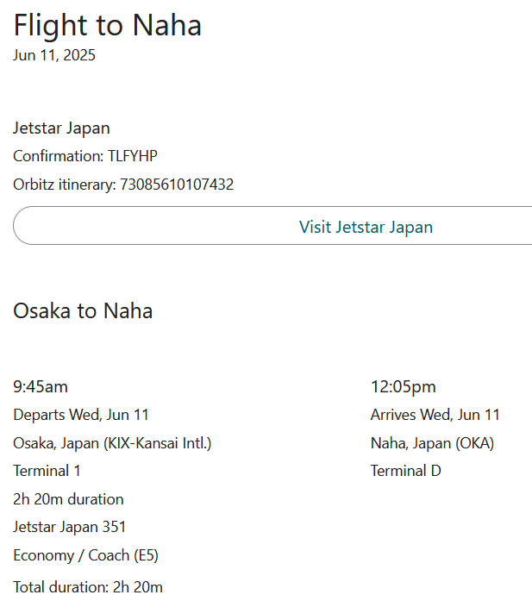
Osaka to Okinawa

Slide 16
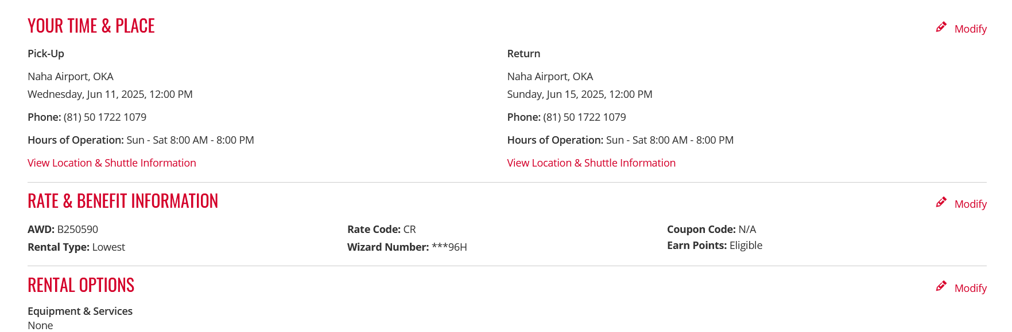
Okinawa Car Rental

Slide 17
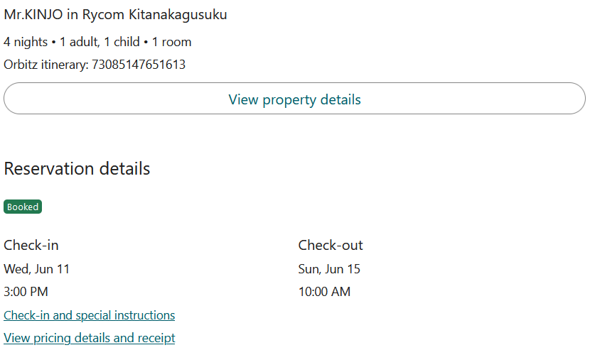
Okinawa Lodging Part I
400 Shimabuku, Kitanakagusuku, Nakagami District, Okinawa 901-2301, Japan

Slide 18
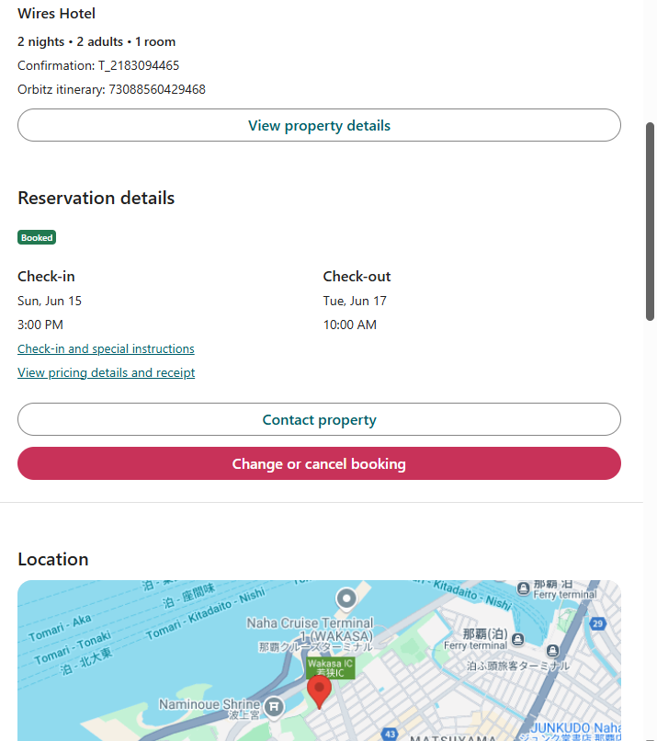
Okinawa Lodging Part II
1 Chome-21-10 Wakasa, Naha, Okinawa 900-0031, Japan

Slide 19
Okinawa Things to Do
Day 1
Aquarium
Day 2
Thrifting
Random beaches
Day 3
Soccer game (Joe)
Day 4 & 5
Chill (Cassie, Jaxon, Eve)

Slide 20
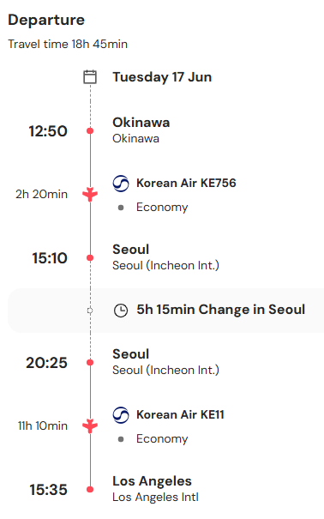
Okinawa to LAX

